Slide 1

Project Control Process in Project Management
2023
Prepared Exclusively for XX
October 2023
Final Report

Slide 2
Table of Contents
Part 1 | Research Overview Research Objectives | 3
Part 2 | Category Overview Category Definition Regulatory Compliance and Standards for Project Control Project Control Process Tools and Technologies | 5
Part 3 | Project Control Frameworks Overview of Popular Project Control Frameworks | 11
Part 4 | Process Benchmarking Project Control Process Benchmarking | 13
Part 5 | Appendix Research Methodology Glossary References | 18

Slide 3
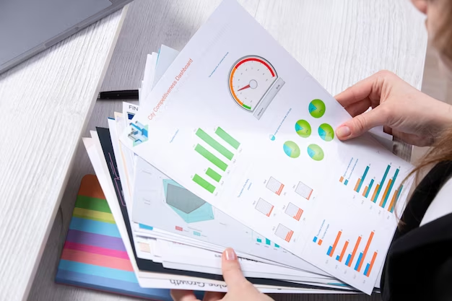
01
Research Overview
Section covered:
Research Objectives
Back to Table of Contents

Slide 4
Research Objectives
Research objectives | Scope
Understand the best practices adopted by organizations in the UK and Ireland with respect to project control in project management Gather insights on project control regulatory compliance and standards along with the tools and technologies adopted Provide an overview of popular project control frameworks and a comparison on frameworks in use Conduct project control process benchmarking including measures adopted with respect to scheduling, cost control, and risk mitigation Provide an overview on project controls and quality assurance methodologies in project management
Click here for Research Methodology

Slide 5
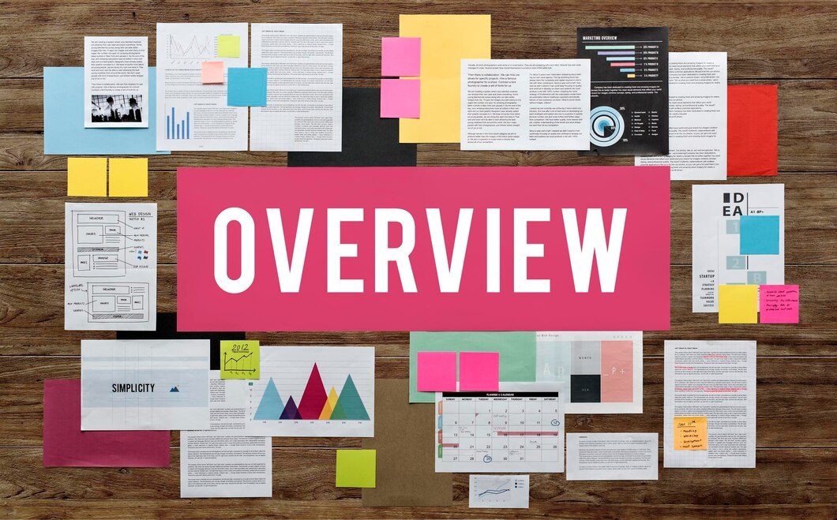
02
Category Overview
Sections covered:
Category Definition
Regulatory Compliance and Standards for Project Control
Project Control Process Tools and Technologies
Back to Table of Contents

Slide 6


Category Definition
Project control is a subset of the project management process that includes two parameters: cost and schedule. The primary goal of the project control process is to keep track of the project's expenses and schedule in relation to the initial predicted schedule and cost. Project control reports aid in the analysis of unanticipated delays, allowing project managers to make decisions that save time and money spent on the process. The project control process aids in improved resource utilization, better decision making, and better coordination.
Project control process
1
2
3
4
Establish baseline
Measure
Analysis
Corrective steps
Project control standards are established beforehand to create a baseline on the project schedule, scope and cost. The baseline becomes the benchmark for measuring and reporting
The baseline varies from project to project.
These parameters are measured and analyzed independently. Setting critical routes and milestones ahead of time aids in efficiently tracking the project schedule. The cost baseline comprises the expected cost of the project as well as all direct and indirect charges
In project control, measuring refers to the act of gathering information about the project. This data can be associated with cost, time, quality, resources, and other aspects. When the project baselines are created, the project can be monitored and measured using it as a reference
This is accomplished using a software application that collects and analyzes project progress data on a continual basis
Reports, dashboards, and checklists are used to showcase this information. Some solutions can also anticipate project data, which helps with project control
Analysis involves gathering and examining the project data to identify deviations from the baseline
The purpose of analysis is that the project control team can collect the data and make useful decisions based on the data collected to manage risk and keep the project on track
The analysis process involves evaluating project progress, forecasting future outcomes based on current measurements, and implementing measures to improve performance. A proper analysis can reveal the root cause of the deviation from the project baseline
The final stage of the project control process is taking corrective actions. Project managers may perform procedures such as changing activities to get back on track and taking remedial actions to remove the obstruction
The project management team implements corrective measures by developing a plan of action to address the root cause and execute preventative measures to ensure that the same deviations do not occur in the future

Slide 7
Regulatory Compliance and Standards for Project Control (1/2)
Standards such as BS 6079:2019, ISO 10006, ISO 21500, and GovS 002 provide project management principles that aid in project control and quality management. These guidelines establish expectations and serve as a guide for project management and project control. Other acts and regulations enacted by the government have improved the safety and effectiveness of the workplace.
Regulatory compliance and standards | Description | Acts and regulations in UK and Ireland
01 British standards for project management | BS 6079:2019 is a project management standard that assists businesses with project management. It also aids in the regulation of management processes and guides organizations in the planning, execution, and control of their projects. Similarly, ISO 10006 and ISO 21500 gives guidelines on project quality management with a particular focus on project management Government Functional Standard “GovS 002: Project Delivery” is a detailed-out guidebook that includes guidelines from the Project Management Book of Knowledge (PMBOK) and Projects In Controlled Environments (PRINCE2), which are the two other guides and standards established by governments and issued by independent institutes. The UK government created PRINCE2 for IT project management, which has since become a standard reference for generic and all forms of project management | ISO 21500:2012 and ISO 10006:2004 are applicable in the UK and Ireland BS 6079:2019 is applicable in the UK PMBOK and PMI institute guidelines are widely recognized in Ireland
02 Data Protection Act | GDPR requires businesses to protect the personal data and privacy of EU citizens for transactions that occur within the EU member states. Non-compliance could result in hefty penalties To mitigate the risk associated with data privacy, project management companies must follow the below mentioned steps: Implement comprehensive policies and procedures for addressing data security, record keeping, and cross-border transfer Implement policy and workflow for executing Data Protection Agreements (DPAs) with vendors and other third parties to ensure processes are compliant with GDPR | The Data Protection Act 2018 is applicale in the UK and Ireland

Slide 8
Regulatory Compliance and Standards for Project Control (2/2)
Regulatory compliance and standards | Description | Acts and regulations in UK and Ireland
03 Health and Safety at Work Act | The Health Safety at Work Act (HSWA) takes into consideration occupational fatalities, injuries, and diseases. The project management companies are bound to follow the HSWA. The key benefits of implementing the Act in the project management activities are as follows: Reduced risk of project functions No fatalities lead to cost savings in various aspects of management Reduced delays and timely completion of tasks as per the planned schedule | Health and Welfare at Work Act 2005 – Ireland The Health and Safety at Work Act 1974 - UK

Slide 9

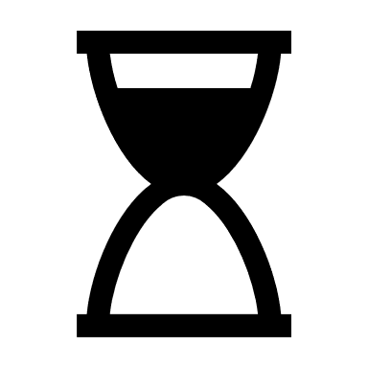
Project Control Process Tools and Technologies (1/2)
Project control tools and technology improve the way project control team manages projects by centralizing work and allowing the team to track project stage, budget, resource allocation, and risk analysis in real time. A better representation of the project stage may be achieved using these technologies, that aid in risk mitigation and resource planning.
01 | Project management software | Key takeaway
Project management software allows the project management team to keep track of all aspects of the project, including timeframes, budgets, and resource allocation. It is a centralized software that handles all types of communications. Project managers and the control team can set up notifications and receive summarized data in the form of dashboards Project management software aids in the better control and management of project tasks, resulting in time and cost savings. Cora PPM, a software by Cora Systems, is one such software used for project control and project management The key features of Cora PPM are as follows: Centralized project data Standardizes the project management process, reducing deviations and improving overall efficiency Data collection and reporting Offers a cloud-based platform providing flexibility and scalability for users |  | A centralized project management software can be used to manage all aspects of the project such as timeframes, budget, resource allocation, and communications
02 | Time-tracking tool | Key takeaway
A time-tracking tool is used to track project task schedule. It can be a separate tool or integrated in a project management tool. Using this information, the project control team can modify the timetable and reallocate resources based on the current project scenario. The visibility on the task provides comprehensive insights into the project's schedule and expense The tool also assists in precisely calculating project deadlines and adjusting as needed Some of the time tracking tools for project control team are Smartsheet, Monday, and Wrike |  | Time-tracking tools are used for better control on project schedule and can be an effective tool for project managers

Slide 10


Project Control Process Tools and Technologies (2/2)
03 | Work Breakdown Structure (WBS) | Key takeaway
WBS is an excellent strategy for distribute project tasks into smaller, more manageable segments. This approach makes project control easier by tracking the time and money of each smaller activity When a work is divided into smaller manageable tasks, it is easier to set project controls for the time spent on each activity and the costs connected with them. Critical path approach and Project Evaluation Review Technique (PERT) are project management methodologies that employ WBS to manage risk The main advantage of employing a work breakdown structure is that it organizes the work and allows for quick examination of the project task at risk |  | WBS can be utilized for any type of project and sector, allowing project management teams to manage risk for every minor activity
04 | Predictive analysis tool | Key takeaway
A predictive analysis tool is used to forecast future results based on the project's historical data. This tool forecasts future data using modeling, machine learning, and statistics. For instance, common tools for predictive analysis include Microsoft Projects, Tableau, Zoho Analytics, and Rapid Miner The key benefits of using a predictive analysis tool for project management are as follows: The historical data estimates work duration and aids in refining the project timeline, assuring project completion on time Contingency plan can be implemented using the data to mitigate project risk Project budget can be estimated using predictive analysis Strategies to manage project spending can be implemented |  | Predictive analytic tools can assist in identifying potential risks and make informed decisions about resource allocation and budgeting, allowing for more informed decisions
05 | Gantt charts | Key takeaway
Gantt charts are a visual depiction of the project's schedule timeframe for each activity. The tools demonstrate how the task is split into smaller segments and the specifics on its timeframes, allowing the project control team to have detailed visibility as well as build contingency plans and budget the project's cost It provides clear visibility on the dependent job and enables the project management team to discover areas of concern and effectively allocate resources For instance, tools such as Microsoft Projects, Smartsheet, GanttPRO, and Zoho Projects are used to make Gantt charts for project management. |  | Gives a visual representation of task and the timeline and makes complex information manageable Simple to use and helps conduct resource planning and tracks the project’s progress

Slide 11

03
Project Control Frameworks
Section covered:
Overview of Popular Project Control Frameworks
Back to Table of Contents

Slide 12
Overview of Popular Project Control Frameworks
Project control frameworks are systematic approaches to manage and oversee projects. In the UK and Ireland, common frameworks include PMBOK, Agile, Lean, and Waterfall, each with distinct methodologies for project management.
Project control framework
Project control frameworks comprise processes, tasks, and tools for structuring project execution. The framework is used in three stages: the project lifecycle, the project control cycle, and the tools. The six key steps of the project life cycle are the beginning the project, planning, execution, monitoring, controlling, and closure. Similarly, the project control cycle includes project monitoring and control, and the tools include existing frameworks and software that may be utilized to accomplish the project plan
Some of the most popular project control frameworks are Agile, Scrum, Kanban, Lean, PMBOK, and Waterfall. These types of frameworks are not just limited to a certain type of industry but have also been widely accepted in a variety of projects and industries
Project control frameworks
Scrum
Kanban
Agile
PMBOK
Lean
Waterfall
It is based on Agile methodology, that divides larger projects into smaller weekly sprints. Sprints are just tasks that the team works on and prioritizes based on the requirements. It places a premium on adaptability and teamwork
Kanban is more related to the visual representation of the project task in the form of boards. These boards focus on the important task and do not complicate the framework, giving a clear visual representation of the project stage and task progression
The agile framework is built on an iterative approach to project management and project control tasks, which is accomplished by breaking tasks down into smaller phases throughout the project life cycle and project control cycle
PMBOK is a foundational guide for various project management frameworks and methodologies. It provides a set of best practices and guidelines accepted as standards in the project management industry
The Lean framework is built on the approach of eliminating waste and enhancing project value. The framework maintains a project-oriented approach that focuses on the value, streamlines the procedures, ensures project flow, eliminates waste, and improves efficiency
It is a traditional framework type. The basic idea behind this framework is that the next task begins only once the previous one is accomplished. In waterfall frameworks, all project tasks have a defined order, and the methodology focuses on sequential project execution

Slide 13
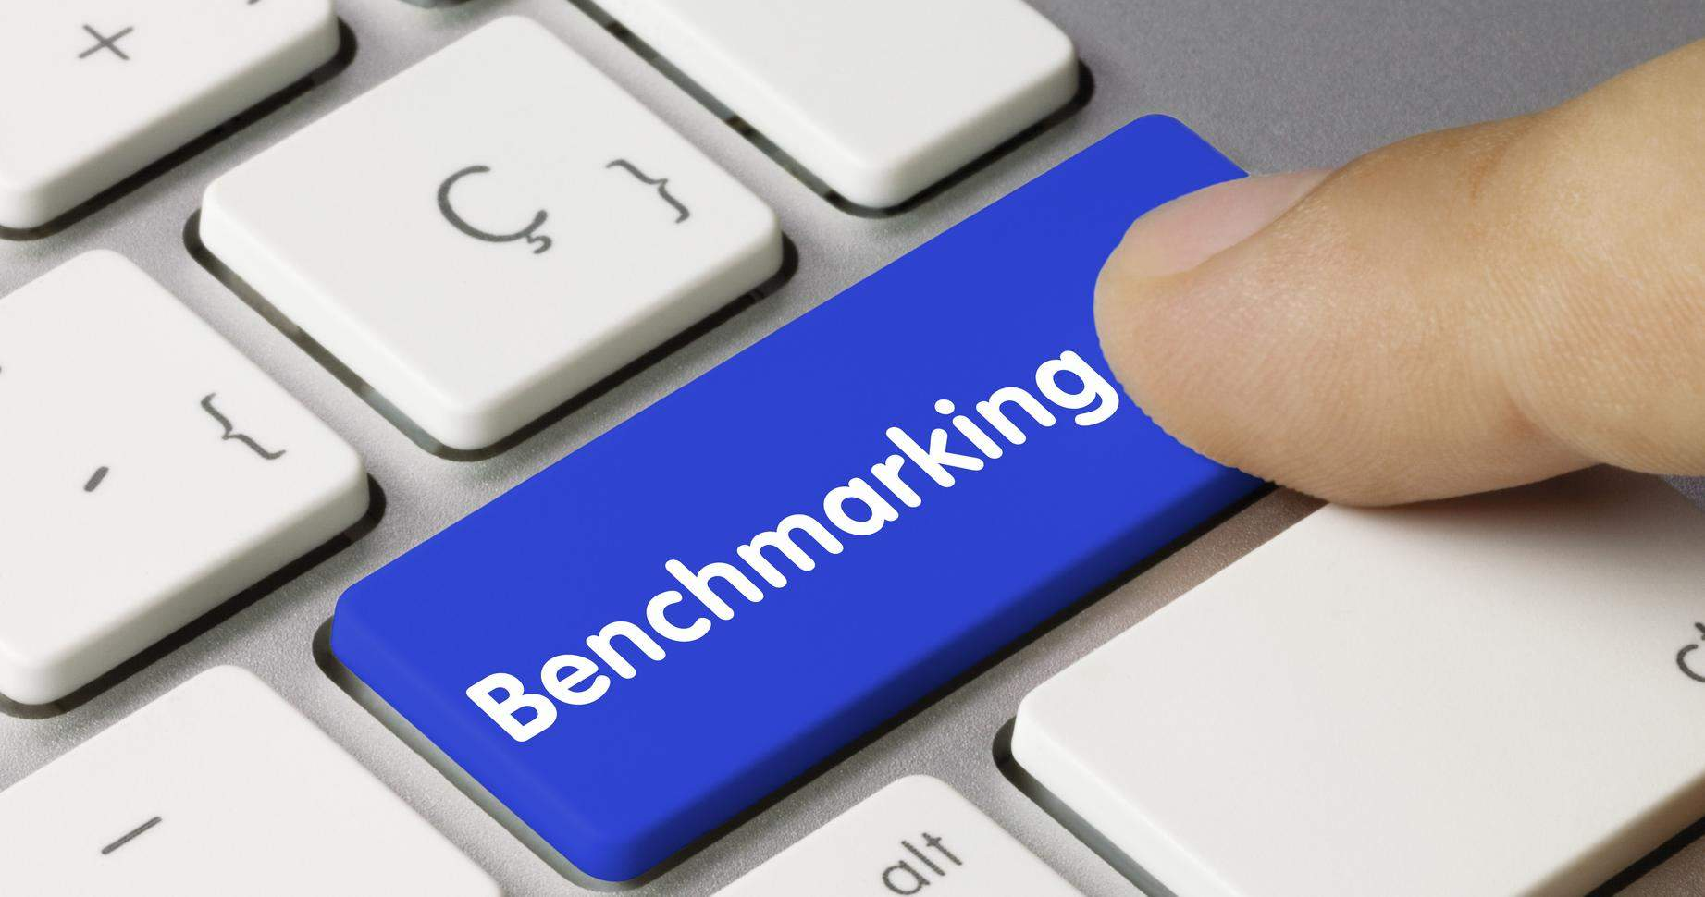
04
Process Benchmarking
Section covered:
Project Control Process Benchmarking
Back to Table of Contents

Slide 14

Project Control Process Benchmarking (1/4)
Water industry associations are introducing various cost and benchmarking tools for organizations to evaluate their performance and cost competitiveness compared to industry peers, fostering greater efficiency and competitiveness within the water industry. Regulatory bodies such as Ofwat are further enhancing this effort by developing specialized cost benchmarking models, encompassing factors such as operating expenses, capital investments, and depreciation to support effective performance evaluation in the water industry.
01 | Leveraging various benchmarking tools and research studies to effectively manage and control costs
Water industry associations are introducing cost and benchmarking tools, including finance and performance benchmarking to help organizations compare their performance and costs with industry peers. Performance benchmarking helps identify weaknesses and improvement opportunities in areas such as water quality, customer service, and operational efficiency by comparing a water utility's performance to others in the industry Different tools included for project cost benchmarking that could be useful for the water industry in the UK and Ireland are as follows: Benchmark UK water industry estimates (AMP8): This tool is tailored for Asset Management Period 8 (AMP8) and offers a comprehensive estimation process. It provides a holistic view of cost estimates, emphasizing sustainability, environmental considerations, and the integration of innovative technologies. These factors contribute to enhanced efficiency, cost reduction, and improved project outcomes Benchmark estimating software: This library-based system aids contractors and water authorities in accurately pricing various projects, including water and sewer projects. It promotes team collaboration, centralizes data management for improved reporting, enhances cost assessments' precision, and provides greater oversight of the supply chain The Comprehensive Economic Partnership Agreement (CEPA) report: Focused on the UK and Ireland, this report summarizes cost estimation and assurance approaches for water projects. It sheds light on diverse cost estimation methods, aiding professionals in selecting the most suitable method for their projects. Furthermore, it outlines assurance approaches to ensure the accuracy and reliability of cost estimates United Kingdom Water Industry Research (UKWIR) reports: These reports offer insights into cost control measures within the UK and Ireland's water industries. They serve as valuable resources for professionals looking to benchmark their performance against other industry players AECOM regulatory submission support: AECOM provides regulatory support for the water industry in the UK, offering data benchmarking across approximately 150 cost models. This support helps identify performance gaps and is complemented by AECOM's publications on asset management and value optimization in the water sector Several cost models are also introduced in this industry, which include various metrics such as operating expenses, capital expenses, and depreciation. For instance, in April 2023, Ofwat, which is the economic regulator for the water sector in England and Wales, developed a cost benchmarking model for water utilities. It involves factors such as operating expenses, capital investments, and depreciation

Slide 15

Project Control Process Benchmarking (2/4)
Companies in the UK and Ireland are adopting various scheduling techniques, including Work Breakdown Structure (WBS), Critical Path Method (CPM), Gantt charts, Agile methodology, and Resource Leveling to enhance cost estimation accuracy, project planning, efficiency, and risk management. Practical implementations such as Shopify Ireland's use of Gantt charts for web design projects showcase the tangible benefits of these techniques in improving project timeline planning and client communication.
02 | Adoption of specific scheduling techniques used in project control processes
Companies in the UK and Ireland are adopting specific techniques that can improve the accuracy of cost estimates, improve project planning, increase efficiency, and improve risk management A few examples of scheduling techniques used in project control processes are as follows: WBS: Hierarchically breaks down projects, aiding in organization and task identification. It can focus on deliverables or project phases. Decomposition, which is a team effort, ensures a comprehensive WBS. It can be outlined in various formats. It defines schedules and resources, predicts costs, reduces surprises, and boosts productivity and efficiency Critical Path Method (CPM): It algorithmically schedules tasks, emphasizing critical activities for timely project completion. The CPM provides a structured framework for managing complex projects and visualizing tasks and dependencies in a network diagram. The benefits include accurate duration estimates, critical task identification, flexible scheduling, and managing dependencies, resources, and risks effectively Gantt charts: It’s a visual representation of project schedules that display task durations, dependencies, and progress tracking for timely adjustments. It complex plans, aiding in monitoring progress and task relationships. It also helps in identifying constraints and allows for quick adjustments. Gantt charts streamline scheduling and execution, ensuring projects stay on track and stakeholders are informed. For large projects, setting up Gantt charts may be more time consuming and intricate due to the abundance of tasks and details involved Agile methodology: Agile is a flexible, collaborative project management approach that emphasizes continuous improvement through iterative processes. It delivers work in small increments, avoiding "big bang" launches. Agile methods such as Scrum and Lean prioritize cross-functional collaboration, dividing projects into smaller phases. It is effective not only for software but also for various team projects Resource leveling: Adjusts schedules for efficient resource allocation, preventing overloads, and ensuring optimal resource utilization. Resource leveling in water projects ensures balanced workloads, maintaining high quality and realistic schedules. It improves focus, reduces burnout, and boosts productivity. Also, prevents overburdening and minimizes delays, optimizing resource usage and improving project management efficiency For instance, in September 2023, Shopify Ireland published an article explaining its utilization of Gantt charts as a strategic tool for web designers in the facilitation of project timeline planning and effective communication with clients. Companies are also opting for recent technologies such as cloud technology to manage and schedule tasks efficiently. For instance, in August 2020, South East Water launched "My Account,“ a digital service offering bill management, payment options, home relocation assistance, and water usage tracking. It uses Firestore for seamless feature updates. Cloud Functions facilitate versatile APIs, ensuring smooth operation across different environments. It employs Pub/Sub for reliable system communication

Slide 16
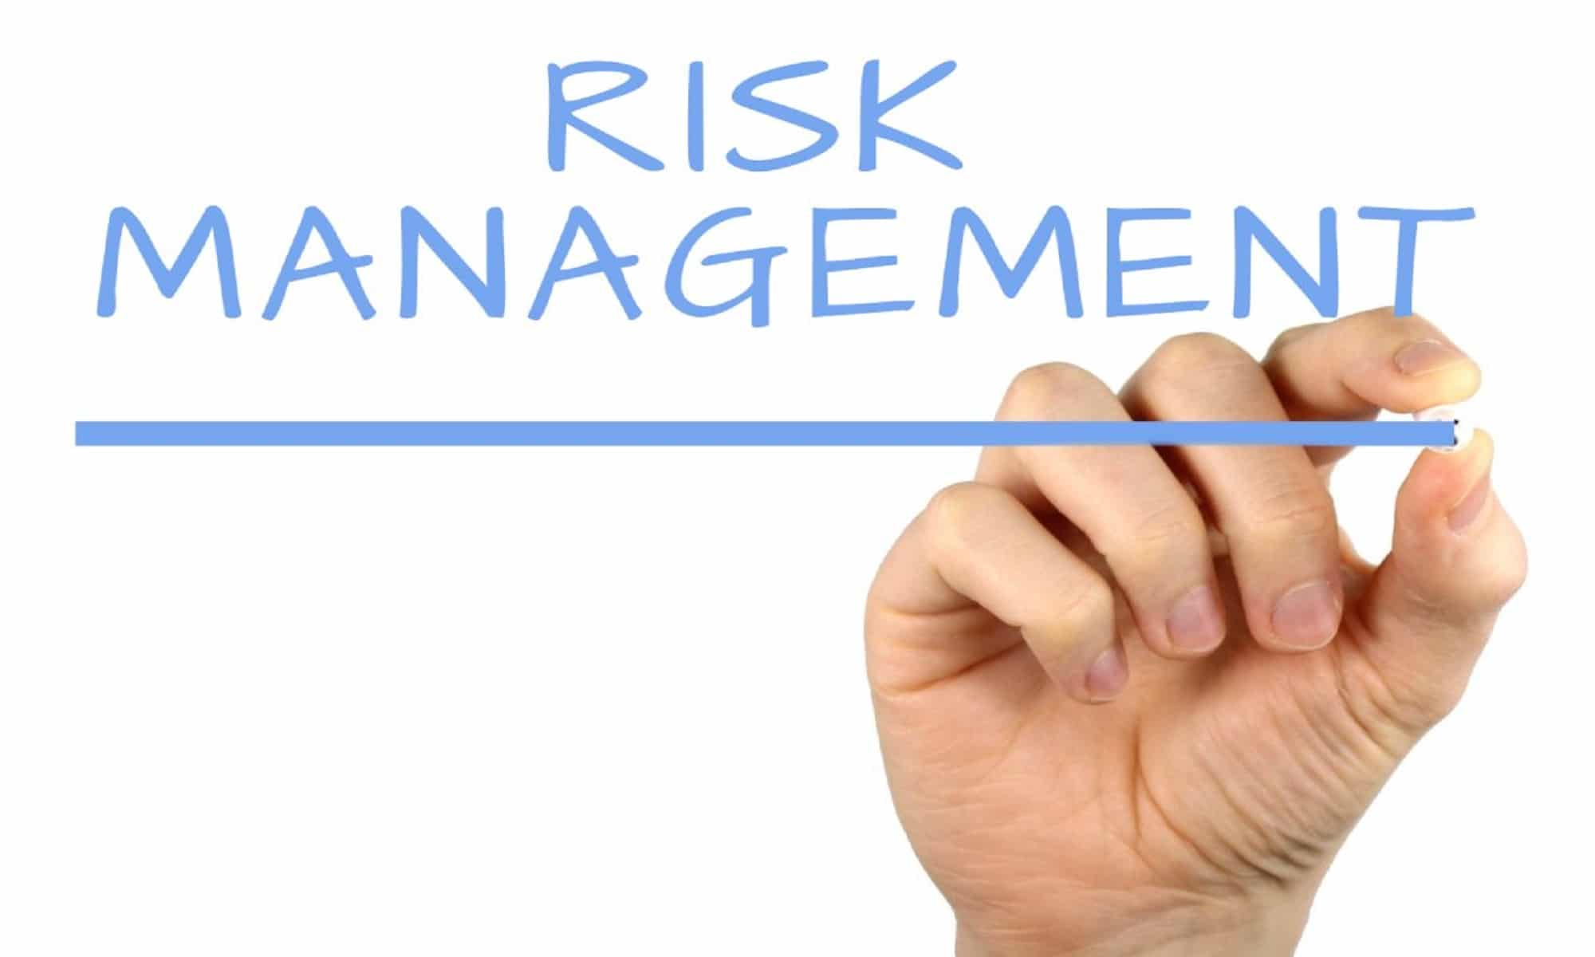
Project Control Process Benchmarking (3/4)
In the water industries in the UK and Ireland, specific tools for benchmarking project risk mitigation are not readily available. However, organizations are addressing this gap by using different resources and advanced technologies such as predictive analytics, ML, and NLP in their project management practices. This approach improves risk evaluation, reduces expenses, and makes project timelines more efficient. This shift is noticeable in industry collaborations and acquisitions such as Blattner Tech's acquisition of a project management solution focused on strengthening project risk management capabilities.
03 | Tools for benchmarking project risk mitigation strategies
There are no specific project risk mitigation benchmarking tools that are tailored to the water industries in the UK and Ireland. However, the below-mentioned are some of the tools and resources that can be useful for risk management in the water industry: Water utility risk management benchmark: It is a methodology for assessing risk management practices in the international water utility sector, aiding utilities in identifying improvement areas. It improves risk practices in the water sector using a capability maturity model. It assesses 11 processes and eight attributes. This approach offers diverse techniques for informed decisions. To apply it effectively, key players should understand the model, assess their current level, identify areas for improvement, and implement changes while monitoring outcomes Water, Sanitation, and Hygiene (WASH) risk assessments: It is a screening tool for in-depth analysis of climate and disaster risks in sectors such as water, assisting utilities in mitigating climate change and disaster-related risks UKWIR water industry reports: They are research reports by UKWIR on the water industry in the UK and Ireland, including insights on risk management practices for performance benchmarking. These reports cover areas such as benchmarking methodology, international industry comparisons, and tools for asset risk management RPS Group expertise: RPS Group offers regulatory support and predictive analysis tools such as PondSIM to help water utilities develop cost-effective asset management strategies and assess flood risks in various environments. RPS Group specializes in data management and analytics, covering ocean measurements, weather models, vessel traffic, and 3D engineering data. These solutions empower water utilities to enhance their asset management and operational performance The integration of predictive analytics with ML and NLP into project management allows for better forecasting and identification of potential issues, helping project managers make informed decisions and adjustments in real time. This leads to cost savings and improved project timelines Organizations are forming alliances and acquiring companies that provide predictive analytics for project management. For instance, in May 2023, Blattner Tech, a global provider of predictive transformation services and tools in the data analytics, AI, and ML sectors, disclosed its acquisition of a project management solution aimed at enhancing companies' project risk management capabilities

Slide 17

Project Control Process Benchmarking (4/4)
Companies are collaborating with AI providers to create smart solutions such as Moody's and Microsoft. In the water industry, AI helps watch water quality, save energy, prevent problems with machines, and protect against cyber attacks, making things safer and more efficient.
04 | Adoption of AI in benchmarking risk mitigation
The advent of AI and its widespread adoption across various processes and tools prompted risk management software providers to engage in collaborations with AI tool providers. These partnerships aim to augment their products and boost overall efficiency. For instance, in June 2023, Moody's Corporation and Microsoft partnered to provide advanced data, analytics, research, and risk solutions to the financial services industry, using Microsoft's AI and Moody's proprietary data to improve corporate intelligence and risk assessment With the use of AI, organizations can enhance efficiency, effectiveness, and sustainability in various industries, including water, agriculture, oil and gas, and critical infrastructure. For instance, in November 2022, tech company, nPlan, partnered with the Transpennine Route Upgrade team, offering its AI forecasting and risk management services. This AI technology will boost project efficiency and effectiveness Similarly, such tools can be used by key players in the water industry to improve project control processes and manage risk. A few examples of the adoption of AI in benchmarking risk mitigation for the water industry are as follows: Real-time water quality monitoring: Enables real-time monitoring and risk detection for water quality, aiding utilities in mitigating quality-related issues Energy efficiency: Optimizes energy usage in treatment plants, cutting costs and emissions for more sustainable operations Predictive maintenance: Predicts equipment failures, reducing downtime and maintenance expenses for enhanced operational efficiency Cybersecurity: Detects and prevents cyber threats, safeguards critical infrastructure, and ensures operational safety

Slide 18

05
Appendix
Sections covered:
Research Methodology
Glossary
References
About Us
Back to Table of Contents

Slide 19
Research Methodology
Hypothesis development
Data Collection
Analysis and Conclusions
Evaluate business requirements
Develop analytical framework
Finalize project approach
Identify secondary information sources such as annual reports, company presentations, and government agencies
Conduct primary interactions with industry experts to validate the findings obtained through secondary sources
Clean and synthesize data
Represent data by organizing, verifying, and tabulating the analysis
Develop insights
Strategic insights
Present findings
Provide actionable recommendations to the client
Back to Research Objectives

Slide 20
Glossary
Acronym | Expansion
AECOM | Architecture, Engineering, Construction, Operations, and Management
AI | Artificial Intelligence
AMP8 | Asset Management Period 8
AQL | Acceptance Quality Limit
BS | British Standard
CEPA | Comprehensive Economic Partnership Agreement
Corp. | Corporation
CPSC | Consumer Product Safety Commission
CPM | Critical Path Method
DPA | Data Processing Agreement
EU | European Union
GDPR | General Data Protection Regulation
GovS | Government Functional Standard
HSWA | Health and Safety at Work Act
Inc. | Incorporation
ISO | International Standards Organization
KEBS | Kenya Bureau of Standards
Acronym | Expansion
ML | Machine Learning
NLP | Natural Language Processing
PERT | Program Evaluation Review Technique
PMBOK | Project Management Book of Knowledge
PPAI | Promotional Products Association International
PRINCE2 | Projects In Controlled Environment
Pty. Ltd. | Proprietary Limited Company
QC | Quality Control
UK | United Kingdom
UKWIR | United Kingdom Water Industry Research
US | United States
WBS | Work Breakdown Structure
Note: Acronyms are arranged in alphabetical order

Slide 21
References
Secondary Sources
https://publications.aecom.com/water/asset-management/projects/regulatory-submission-support-in-the-water-industryhttps://publications.aecom.com/water/asset-management/projects/regulatory-submission-support-in-the-water-industry https://ukwir.org/water-industry-research-reports https://www.benchmarkestimating.com/industries/water-and-sewer/ https://www.ofwat.gov.uk/publication/approaches-for-estimating-and-benchmarking-costs-for-large-scale-water-infrastructure-projects-a-report-for-ofwat-and-rapid-by-cepa/ https://www.benchmarkestimating.com/benchmark-uk-water-industry-estimating/ https://www.shopify.com/in/partners/blog/105134854-a-web-designer-s-guide-to-project-schedules https://monday.com/blog/project-management/project-scheduling-101/ https://www.getclockwise.com/blog/project-management-scheduling-techniques https://www.runn.io/blog/project-scheduling-techniques https://teamdeck.io/project-management/project-scheduling-techniques/ https://projectmanagementacademy.net/resources/blog/scheduling-methodology-pmp/ https://datatechvibe.com/news/blattner-tech-acquires-a-project-management-solution-to-expand-its-predictive-analytics-capabilities/ https://dspace.lib.cranfield.ac.uk/bitstream/handle/1826/2925/Benchmarking%20risk%20management-water%20utility%20sector-Pt%201-design%20method-2007.pdf?isAllowed=y&sequence=1 https://dspace.lib.cranfield.ac.uk/handle/1826/2797 https://www.ecosys.net/knowledge/what-is-project-controls/#:~:text=What%20Are%20Project%20Controls%3F,out%20project%20costs%20and%20schedule. https://www.knowledgehut.com/blog/project-management/what-is-project-controls https://pmstudycircle.com/project-controlling/
Secondary Sources
https://www.waterworld.com/wastewater/article/14222700/ai-water-breakthrough https://www.mdpi.com/2073-4441/14/9/1384 https://www.europarl.europa.eu/RegData/etudes/STUD/2021/662906/IPOL_STU(2021)662906_EN.pdf https://www.anglianwater.co.uk/siteassets/household/about-us/five-point-plan-for-innovation-acceleration-2022.pdf https://www.rpsgroup.com/sectors/water/uk-and-ireland-regulated-water-asset-management/innovation/innovation/ https://www.rpsgroup.com/sectors/water/uk-and-ireland-regulated-water-asset-management/ https://www.sanitationandwaterforall.org/tools-portal/tool/risk-assessments-wash https://www.smartsheet.com/content/project-controls https://www.projectmanager.com/guides/gantt-chart https://www.linkedin.com/pulse/best-technologies-project-management-sean-desmond-mpm-pmp/ https://www.smartsheet.com/content/gantt-chart-pros-cons https://apmg-international.com/article/uk-government-standard-project-delivery https://www.bsigroup.com/en-GB/standards/bs-6079-project-management/ https://www.itgovernance.co.uk/dpa-2018#:~:text=The%20Data%20Protection%20Act%202018,data%20erased%20in%20certain%20circumstances. https://www.hse.gov.uk/legislation/hswa.htm#:~:text=The%20Health%20and%20Safety%20at,and%20members%20of%20the%20public

